Slide 1
Clustering Methods in Machine Learning

Slide 2
Outline
What is cluster analysis?
Background
Unsupervised
Distance functions
Description and Explanation of algorithms
Partitional algorithms: K-means
An example for K means clustering

Slide 3
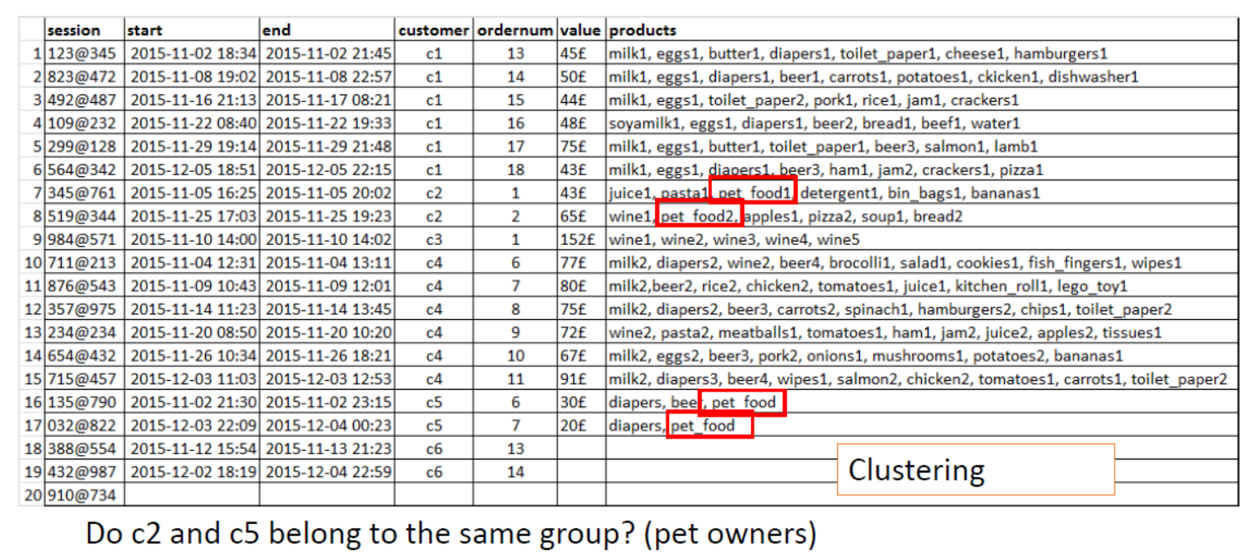

Slide 4
What is Cluster analysis?
“Finding groups of objects such that the objects in a group will be similar (or related) to one another and different from (or unrelated to) the objects in other groups.” [Tan, 2014]
No a priori class labels
No knowledge of what is “correct”
Attempt to understand how different data points are related to each other
Greater similarity in a group, greater difference between groups -> better clustering

Slide 5
Background
Supervised have access to class-labels
Unsupervised doesn’t
train a model similar to a supervised model
need ground truth
Clustering is the partitioning of data into subgroups
According to e.g. a distance function
Two primary settings:
Predictive clustering – trying to predict the cluster an instance belongs to
Descriptive clustering – clustering data to discover how instances are connected

Slide 6
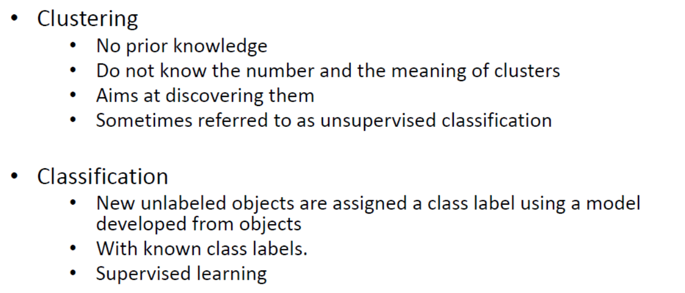
Clustering vs. classification

Slide 7
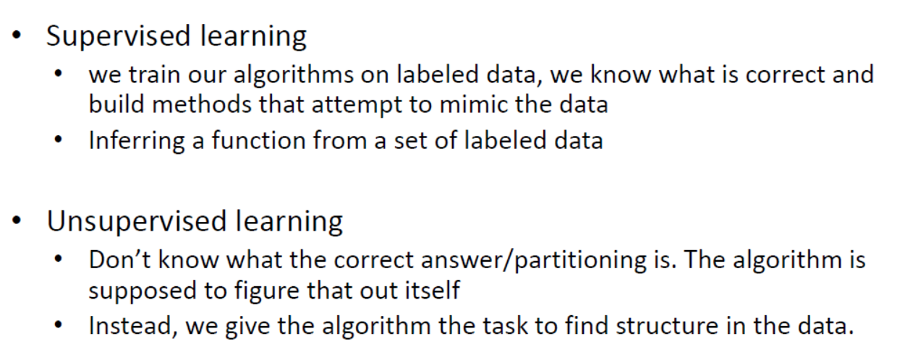
Cont.

Slide 8
Background
Hard cluster approaches
Instances belong to only one cluster
Often heuristic, i.e. provides a good enough cluster solution
Most common approach
Soft cluster approaches
Instances can belong to several clusters
Sometimes called Fuzzy cluster

Slide 9
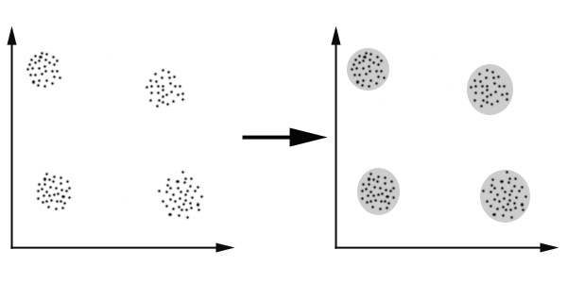
Clustering
Clustering can be considered the most important unsupervised learning problem
The goal of clustering is to reduce the amount of data by categorizing or grouping similar data items together.

Slide 10
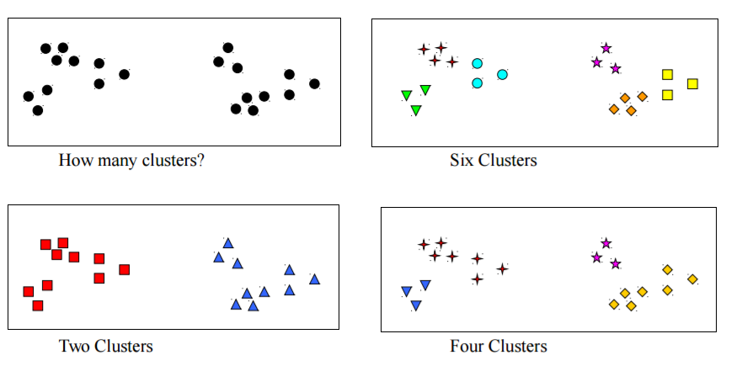
Clustering
Notes:
Elbow method

Slide 11
Applications of cluster analysis
Marketing: finding groups of customers with similar behaviour given a large database of customer data containing their properties and past buying records;
Biology: classification of plants and animals given their features;
Libraries: book ordering;
Insurance: identifying groups of motor insurance policy holders with a high average claim cost; identifying frauds;
City-planning: identifying groups of houses according to their house type, value and geographical location;
Earthquake studies: clustering observed earthquake epicenters to identify dangerous zones;
WWW: document classification; clustering weblog data to discover groups of similar access patterns.

Slide 12
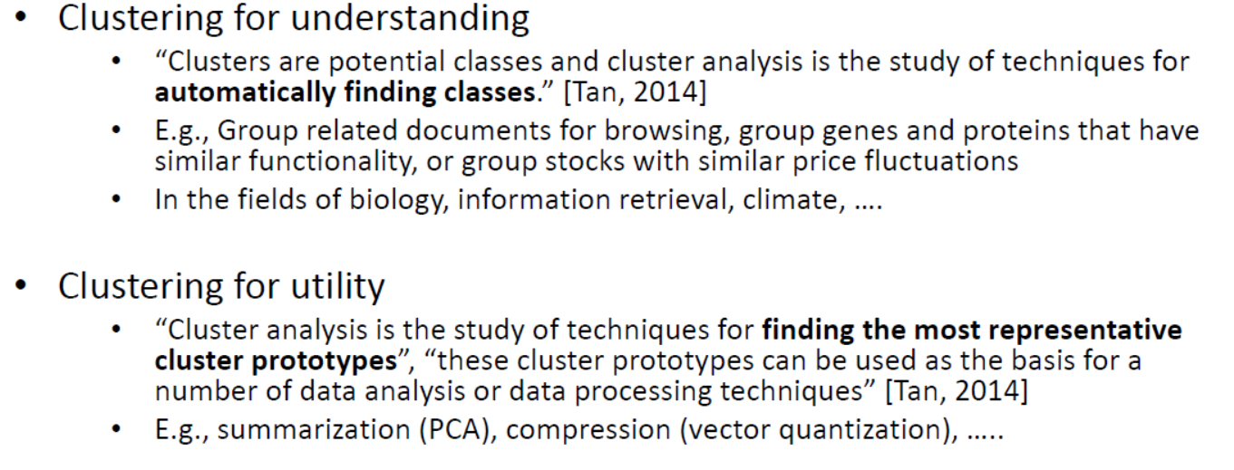
Applications of cluster analysis

Slide 13
Descriptive clustering
Explorative clustering
Provide knowledge about the data
Can only be used to provide knowledge about the data
Can’t predict new instance
Can be performed by first clustering and then finding the set of features associated with each cluster.

Slide 14
Example algorithms
Most algorithms assume there are k number of clusters
Often uses a distance function to compare similarity of instances
Defines a distance between two points in a set
Distance function is dependant on the data and problem
Euclidian distance is common (requires numerical data)
Jaccard distance, Manhattan distance and others
The choice of algorithm depends on the problem
Each algorithm is suited for different areas, or different problems
Each algorithm is suited for different types of data
Important that the choice of algorithm is carefully considered
Algorithm affects the clustering solution

Slide 15
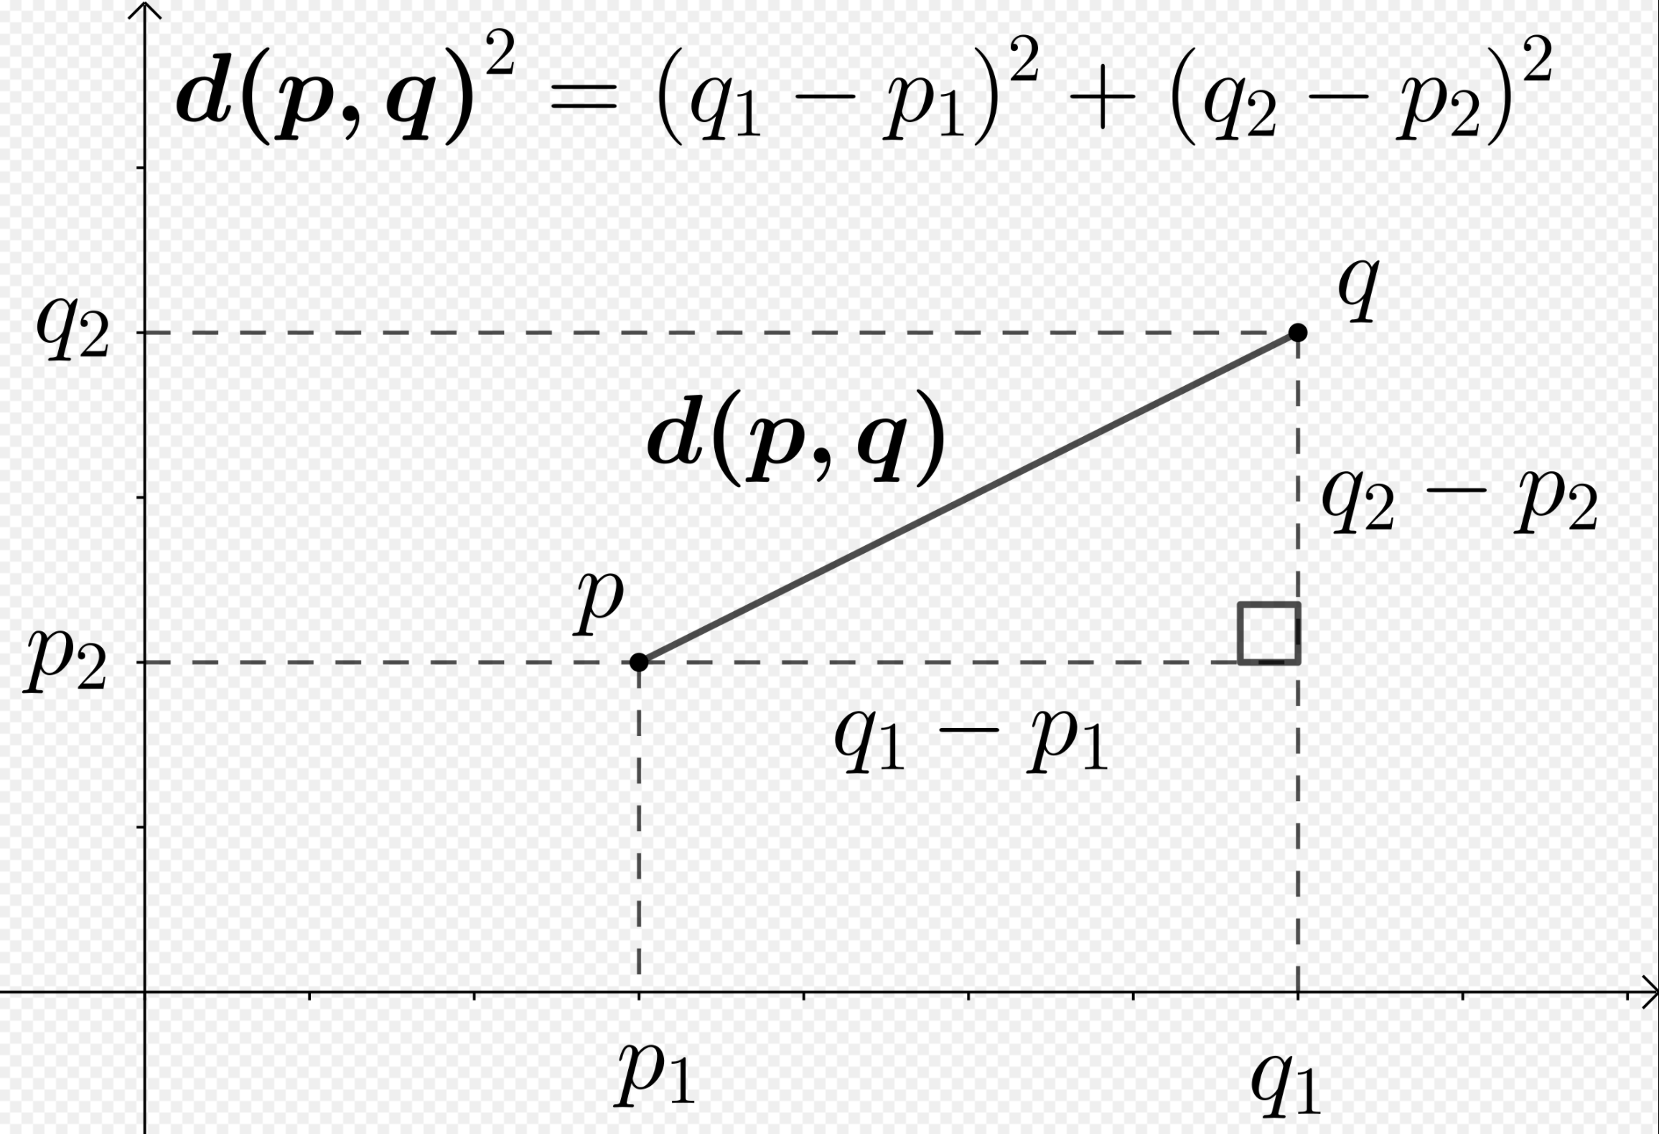
Two Dimensional Euclidian Distance

Slide 16
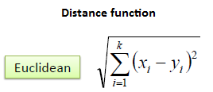
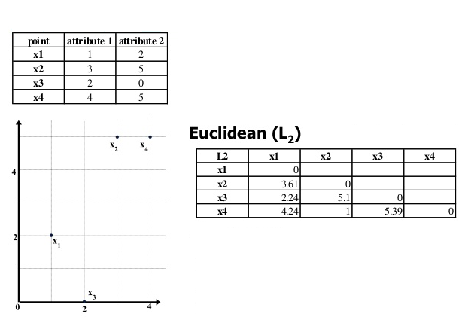
Euclidian distance
Dist(x₁,x₂)= sqrt((3-1)²+(5-2)²)= 3.61

Slide 17
K-means Overview
An unsupervised clustering algorithm
“K” stands for number of clusters, it is typically a user input to the algorithm; some criteria can be used to automatically estimate K
It is an approximation to an NP-hard combinatorial optimization problem
K-means algorithm is iterative in nature
It converges, however only a local minimum is obtained
Works only for numerical data
Easy to implement

Slide 18
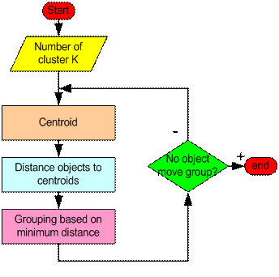
How the K-Means Clustering algorithm works?

Slide 19
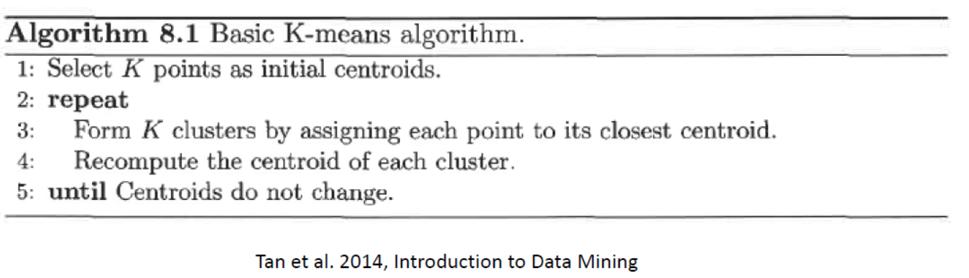
The Algorithm

Slide 20
K-means clustering algorithm
Place K points into the space represented by the objects that are being clustered. These points represent initial group centroids.
Assign each object to the group that has the closest centroid.
When all objects have been assigned, recalculate the positions of the K centroids.
Repeat Steps 2 and 3 until the centroids no longer move. This produces a separation of the objects into groups from which the metric to be minimized can be calculated.

Slide 21
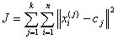
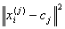
K-means clustering
This algorithm aims at minimizing an objective function, in this case a squared error function. The objective function
where is a chosen distance measure between a data point and the cluster centre , is an indicator of the distance of the n data points from their respective cluster centres.

Slide 22
Example 1:
Lets assume that we have 4 different medicines and we want to cluster these medicines into
two different clusters
 | Weight index | pH value
Medicine A | 1 | 1
Medicine B | 2 | 1
Medicine C | 4 | 3
Medicine D | 5 | 4

Slide 23
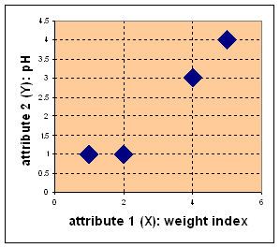
Example 1:
Graphical representation:
 | Weight index | pH value
Medicine A | 1 | 1
Medicine B | 2 | 1
Medicine C | 4 | 3
Medicine D | 5 | 4

Slide 24
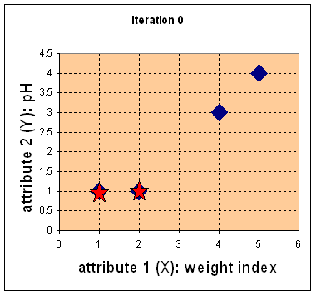
Example 1:
Step 0: Randomly initialize centroids

Slide 25
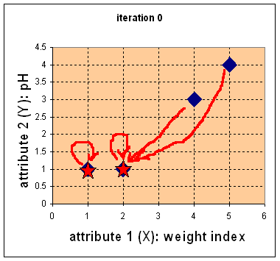
Example 1:
Step 1: Find closest centroid to each data point using Euclidean distance
Dist(A, c1)= sqrt((1-1)²+(1-1)²)=0
Dist(B, c1)= sqrt((1-2)²+(1-1)²)=1
Dist(C, c1)= sqrt((1-4)²+(1-3)²)=3.61
Dist(D, c1)= sqrt((1-5)²+(1-4)²)=5
Dist(A, c2)= sqrt((2-1)²+(1-1)²)=1
Dist(B, c2)= sqrt((2-2)²+(1-1)²)=0
Dist(C, c2)= sqrt((2-4)²+(1-3)²)=2.83
Dist(D, c2)= sqrt((2-5)²+(1-4)²)=4.24
CLASS1: A
CLASS2: B, C, D

Slide 26
Example 1:
Step 2: Recompute centroid for each group. New centroid (c₁, c₂, ..., c_{n}) for the cluster C is found through:
c₁ = ∑_{Xj ∈ C} ( x_{j1} ) / |n₁|
c₂ = ∑_{Xj ∈ C} ( x_{j2} ) / |n₂|
Where n₁+n₂=n
In this case, for our example, new centroids are calculated as:
c_{1,x} = (1)/1 = 1
c_{1,y} = (1)/1 = 1
c_{2,x} = (2 + 4 + 5)/3 = 3.666
c_{2,y} = (1 + 3 + 4)/3 = 2.666

Slide 27
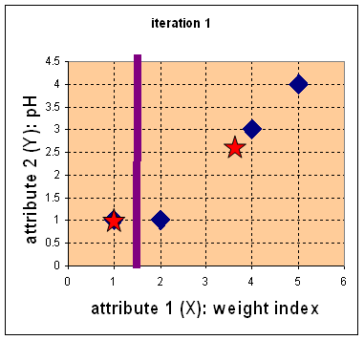
Example 1:
Find nearest centroid using Euclidean distance
Dist(A, c1)= sqrt((1-1)²+(1-1)²)=0
Dist(B, c1)= sqrt((1-2)²+(1-1)²)=1
Dist(C, c1)= sqrt((1-4)²+(1-3)²)=3.61
Dist(D, c1)= sqrt((1-5)²+(1-4)²)=5
Dist(A, c2)= sqrt((3.66-1)²+(2.66-1)²)=3.14
Dist(B, c2)= sqrt((3.66-2)²+(2.66-1)²)=2.36
Dist(C, c2)= sqrt((3.66-4)²+(2.66-3)²)=0.47
Dist(D, c2)= sqrt((3.66-5)²+(2.66-4)²)=1.89
CLASS1: A, B
CLASS2: C, D

Slide 28
Example 1:
Step 2: Recompute centroid for each group New centroid (c₁, c₂, ..., c_{n}) for the cluster C is found through:
c₁ = ∑_{Xj ∈ C} ( x_{j1} ) / |n₁|
c₂ = ∑_{Xj ∈ C} ( x_{j2} ) / |n₂|
Where n₁+n₂=n
In this case, for our example, new centroids are calculated as:
c_{1,x} = (1+2)/2 = 1.5
c_{1,y} = (1+1)/2 = 1
c_{2,x} = (4 + 5)/2 = 4.5
c_{2,y} = (3 + 4)/2 = 3.5

Slide 29
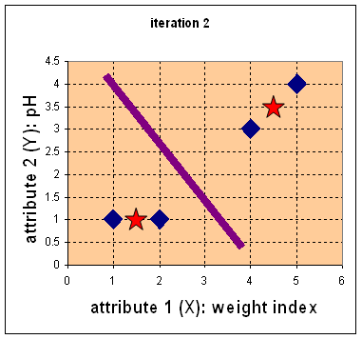
Example 1:
Find nearest centroid using Euclidean distance
Dist(A, c1)= sqrt((1.5-1)²+(1-1)²)=0.5
Dist(B, c1)= sqrt((1.5-2)²+(1-1)²)=0.5
Dist(C, c1)= sqrt((1.5-4)²+(1-3)²)=3.2
Dist(D, c1)= sqrt((1.5-5)²+(1-4)²)=4.61
Dist(A, c2)= sqrt((4.5-1)²+(3.5-1)²)=4.30
Dist(B, c2)= sqrt((4.5-2)²+(3.5-1)²)=3.54
Dist(B, c2)= sqrt((4.5-4)²+(3.5-3)²)=0.71
Dist(B, c2)= sqrt((4.5-5)²+(3.5-4)²)=0.71
CLASS1: A, B
CLASS2: C, D
*Iteration is completed and optimal solution is obtained.

Slide 30
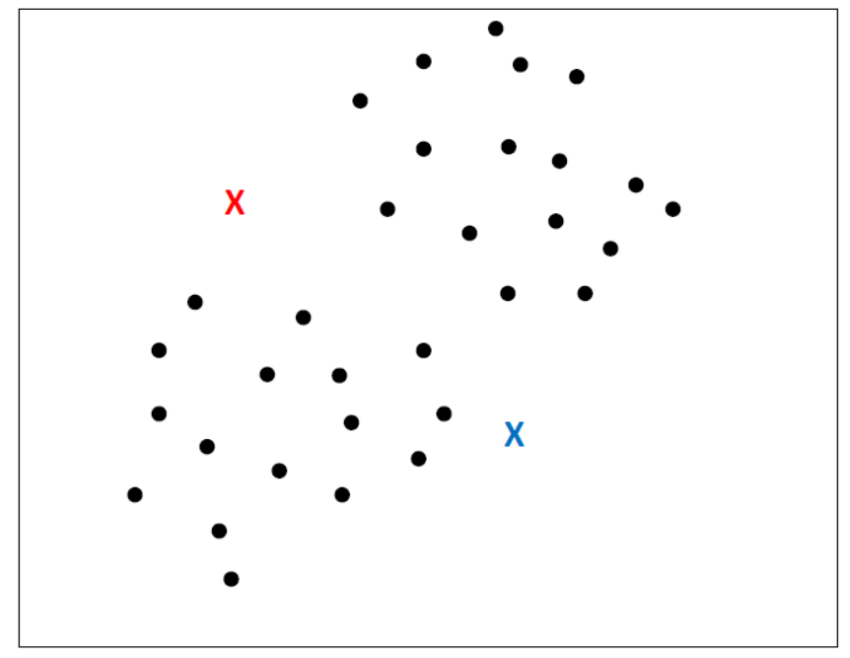
Initialization

Slide 31
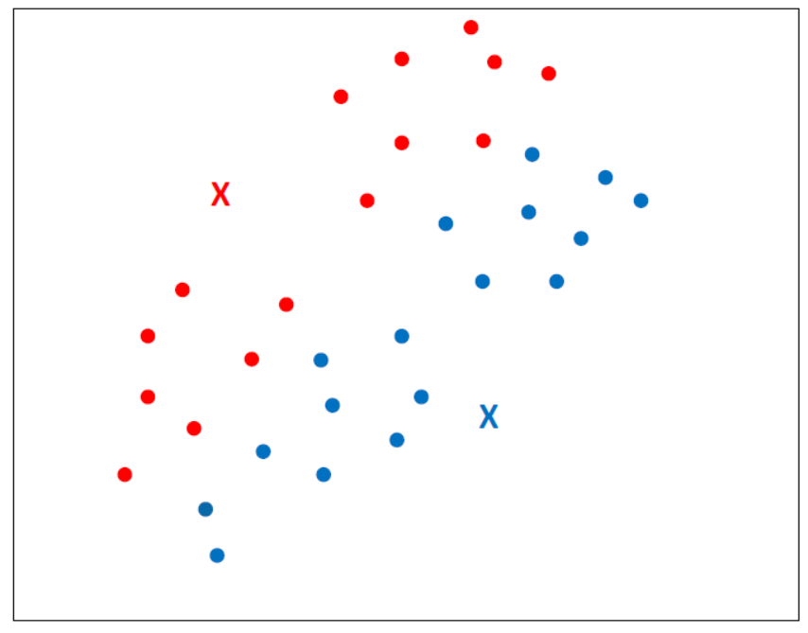
Assignment

Slide 32
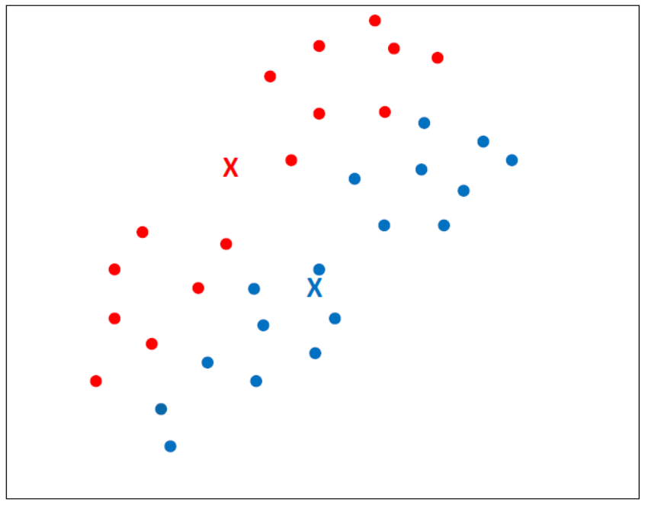
Update

Slide 33
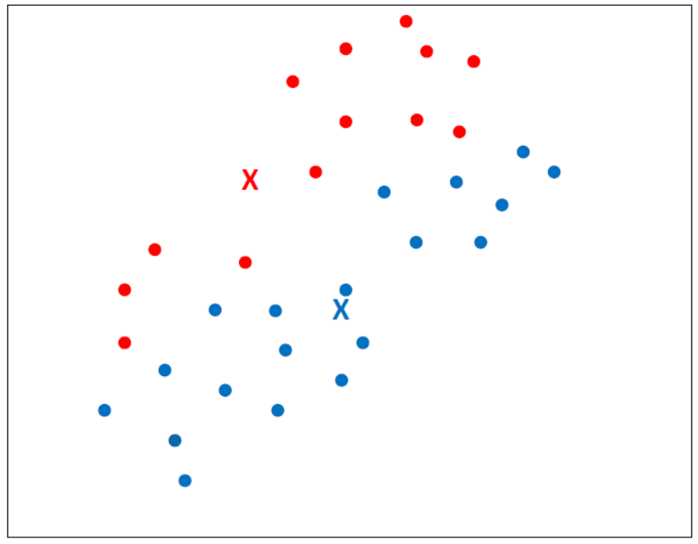
Assignment

Slide 34
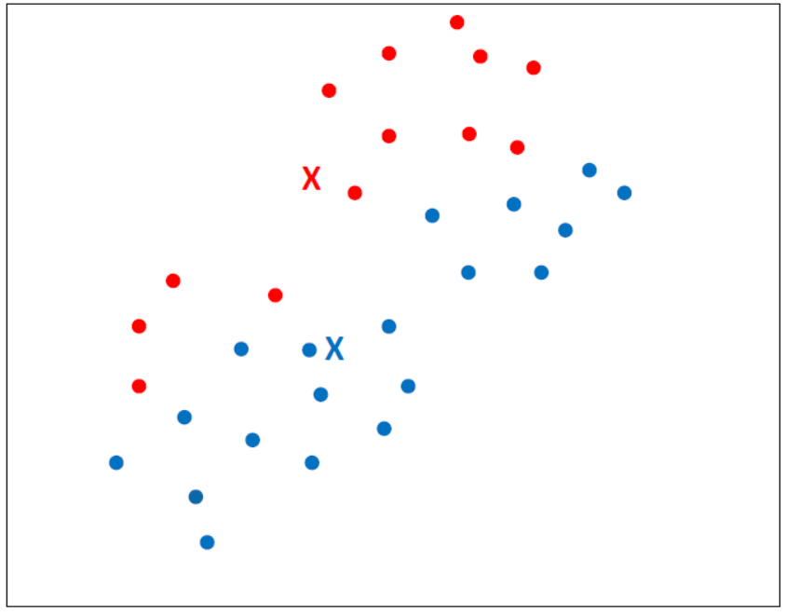
Update

Slide 35
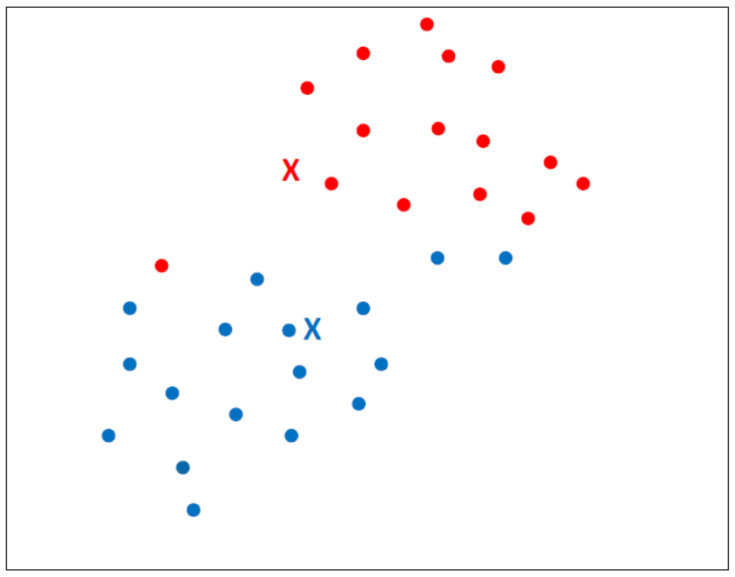
Assignment

Slide 36
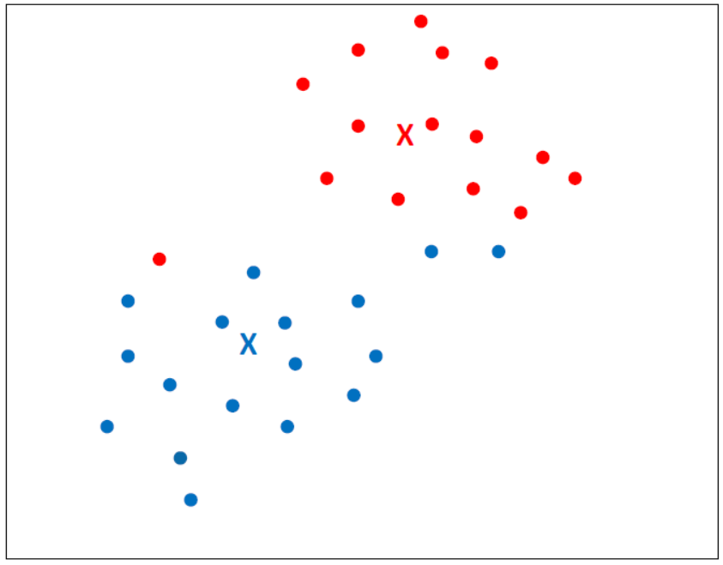
Update

Slide 37
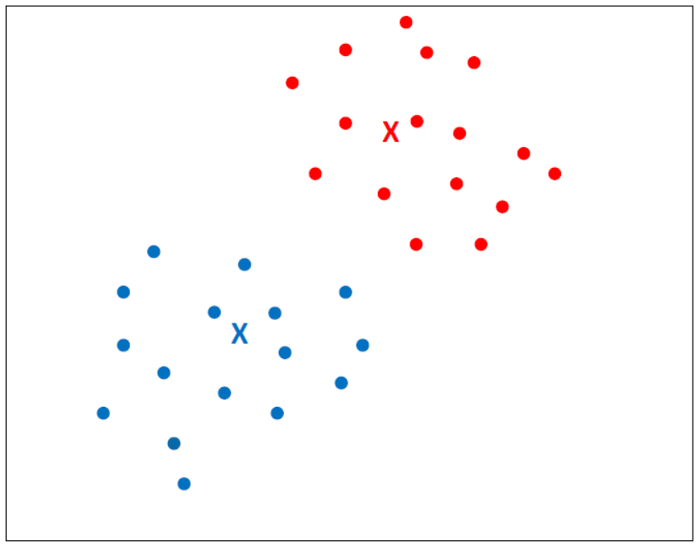
Assignment

Slide 38
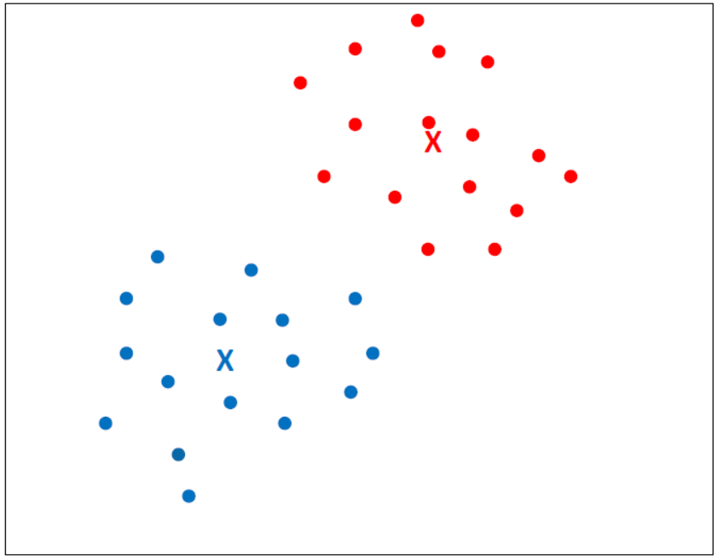
Update

Slide 39
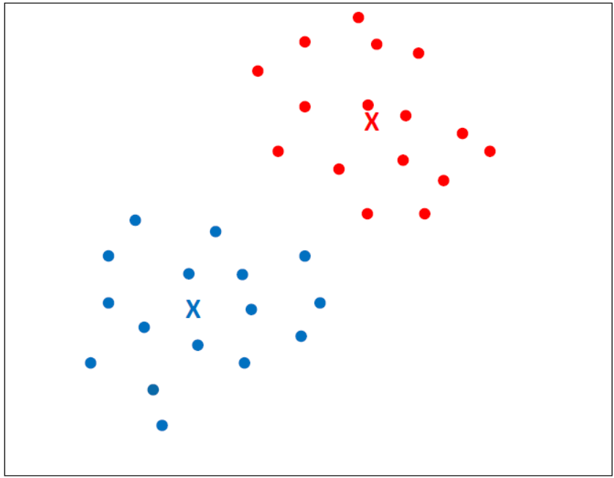
Assignment (no change)

Slide 40
Exercise
Use K means clustering to cluster the following data. (Use K=2)
Use the same initial centroid points from the previous example.
 | Weight index | pH value
Medicine A | 2 | 2
Medicine B | 2 | 4
Medicine C | 1 | 3
Medicine D | 6 | 4
Medicine E | 3 | 3
Medicine F | 1 | 6

Slide 41
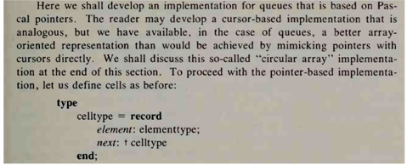
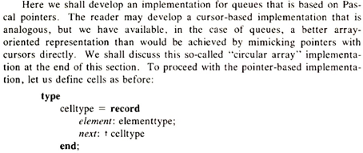
Example 2:
Image Binarization: which means that we need to cluster pixel values into two clusters, white
as a class 1 and black as class 2.
Notes:
Image binarization is the process of taking a grayscale image and converting it to black-and-white, essentially reducing the information contained within the image from 256 shades of gray to 2: black and white, a binary image.

Slide 42
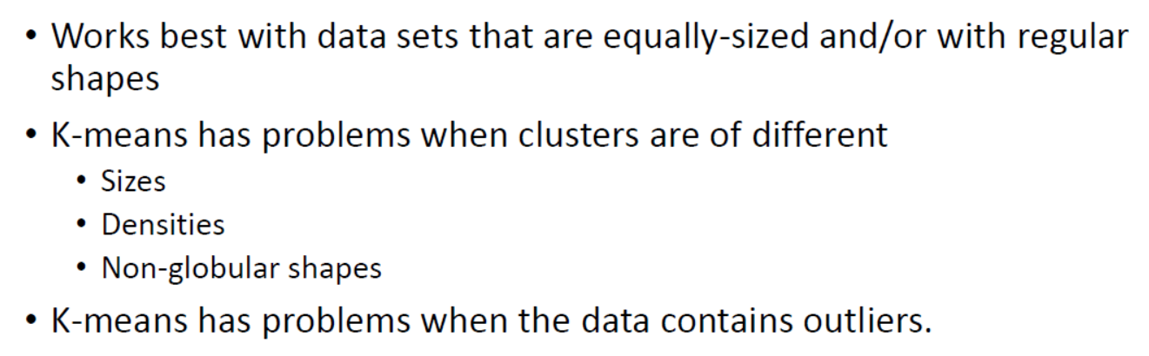
Limitations of K-means

Slide 43
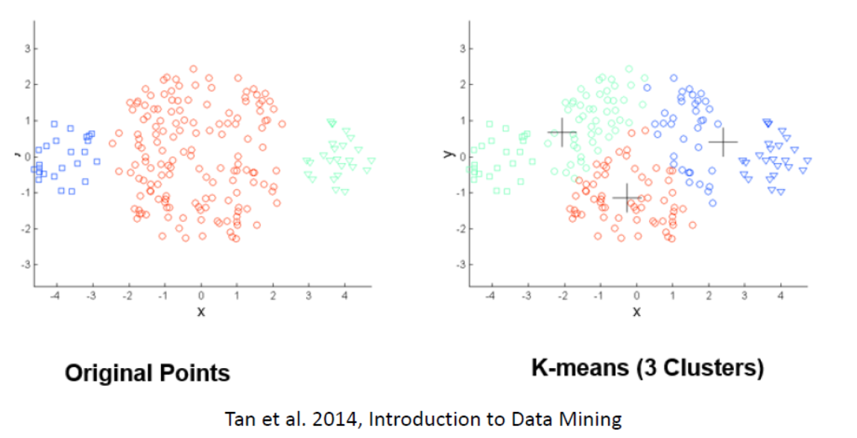
K-means with clusters of different sizes

Slide 44
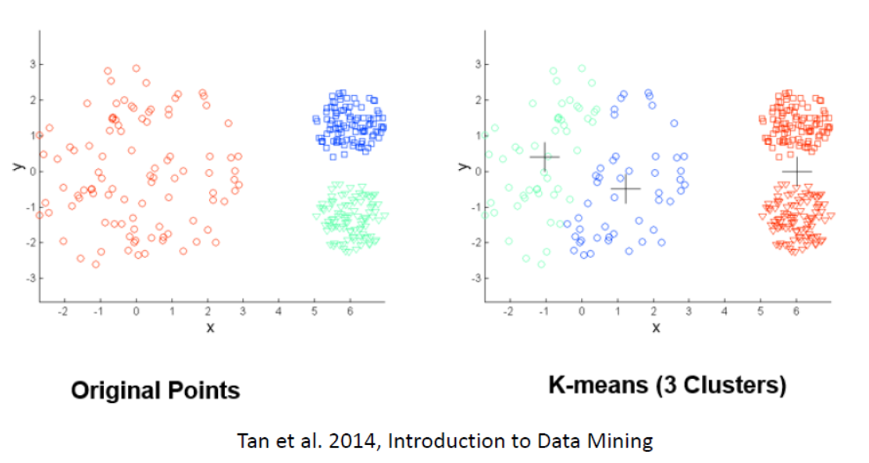
K-means with clusters of different density

Slide 45
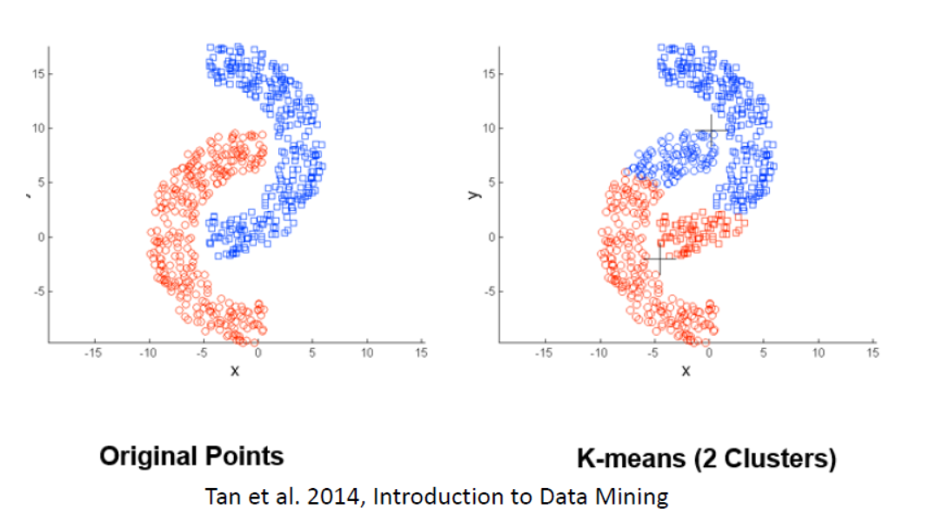
K-means with clusters of non-globular shapes

Slide 46
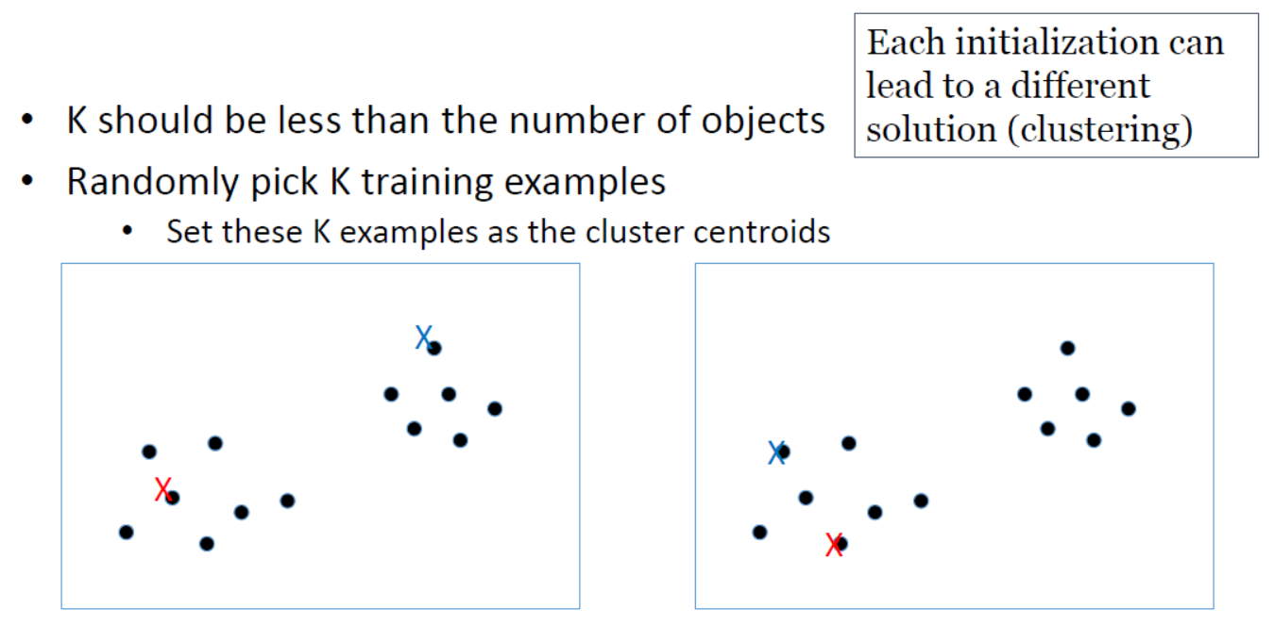
Initializing K-means

Slide 47
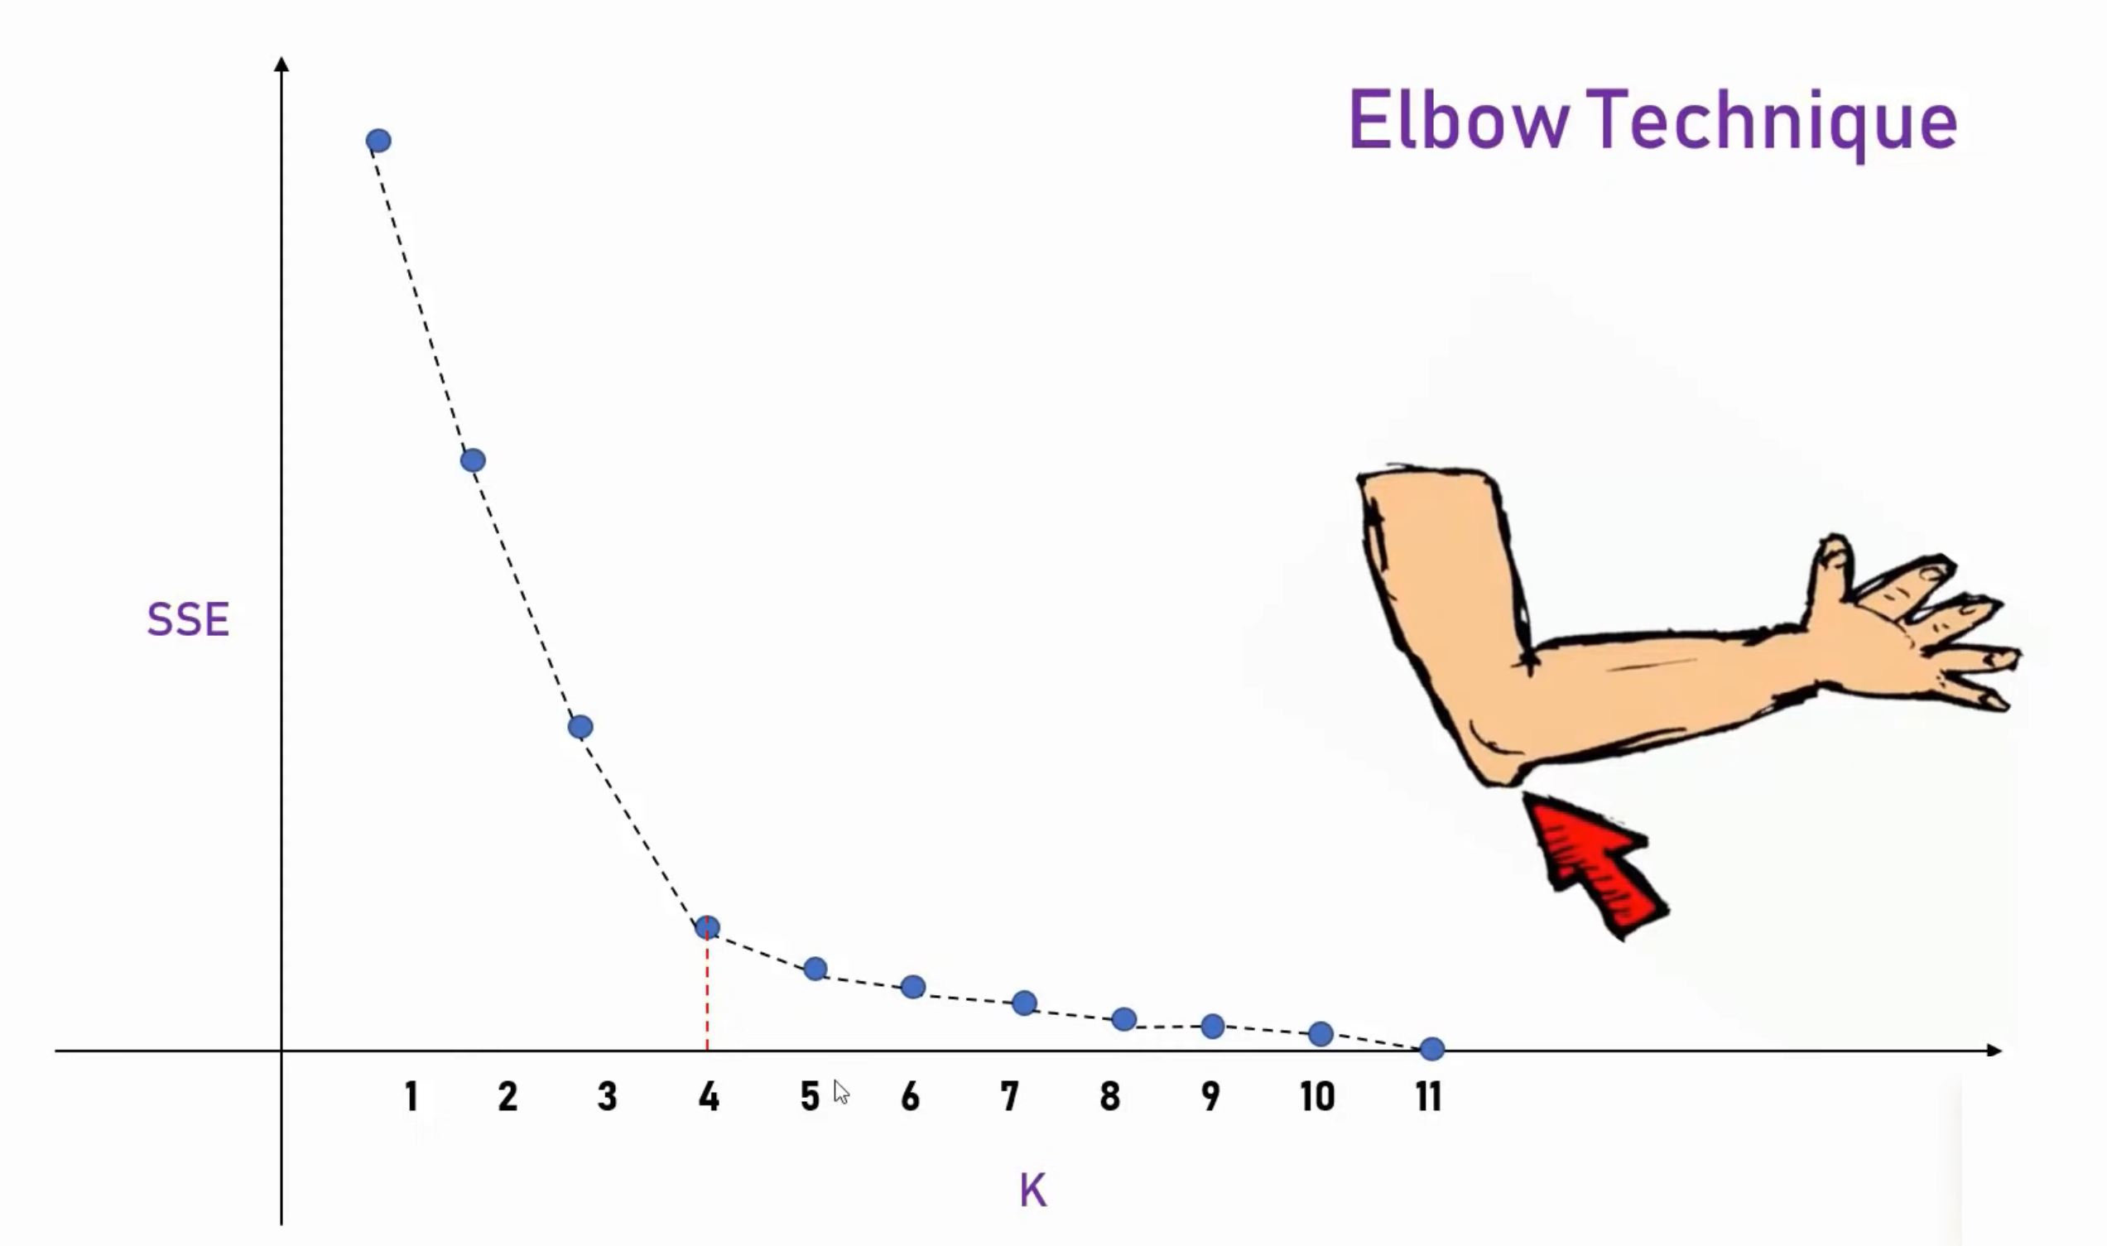

Slide 48
